Slide 1
A Line-to-sketch Image Translation Model Based on MUNIT
Wang Zhiyuan · Ning Zhenyu ·
Zhang Luyi

Slide 2
Task description
01

Slide 3
Challenge Task
01
Artist drawing heavidepends on the level of personal expertise, and each picture requires a lot of time and effort.
Most common portrait sketch image generation methods are based on the input of character photos to produce sketch pictures
Our goal: to devise a line-to-sketch image translation model

Slide 4
Model Prototype
02

Slide 5
Line-to-sketch translation model
02
——a variant of the MUNIT
(Multimodel Unsupervised Image-to-image Translation)

Slide 6
Multimodel Unsupervised Image-to-image Translation
MUNIT (Multimodel Unsupervised Image-to-image Translation) model is an unsupervised image-to-image translation model, which can translate an image to a new image with same content but different style.

Slide 7
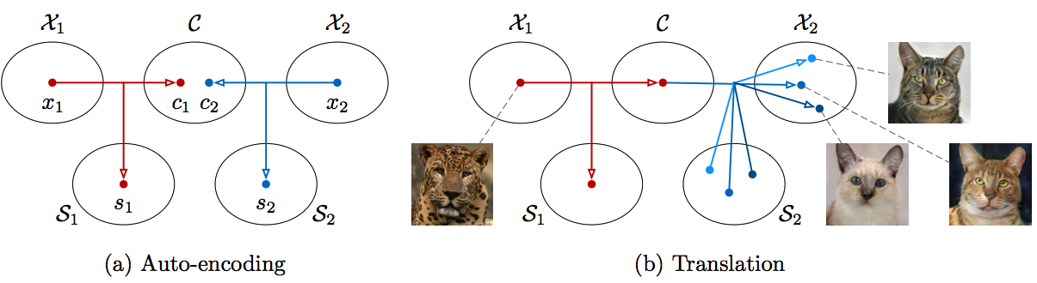
MUNIT: two fundamental assumptions
Assumption 1: the latent space of images can be separated into distinct content and style spaces.
Assumption 2: images from different domains, while sharing a common content space, have unique style spaces.

Slide 8
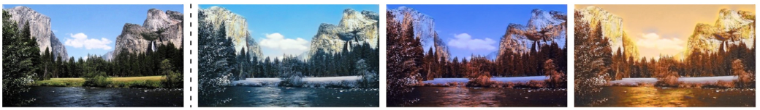
MUNIT: two fundamental assumptions
For example:
Content space: mountains and river
Style space: seasons

Slide 9
Model Overview
03

Slide 10
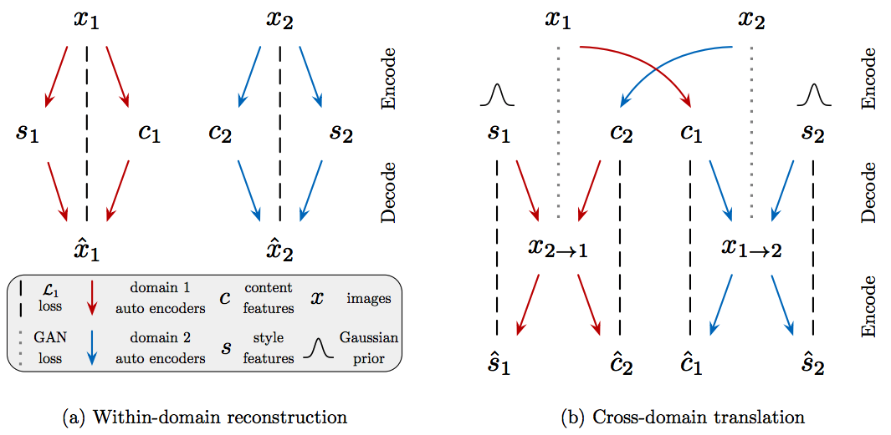
Within-domain and cross-domain
Within-domain reconstruction
training process
train encoder and decoder
Cross-domain translation
gererating process
line-to-sketch translation

Slide 11
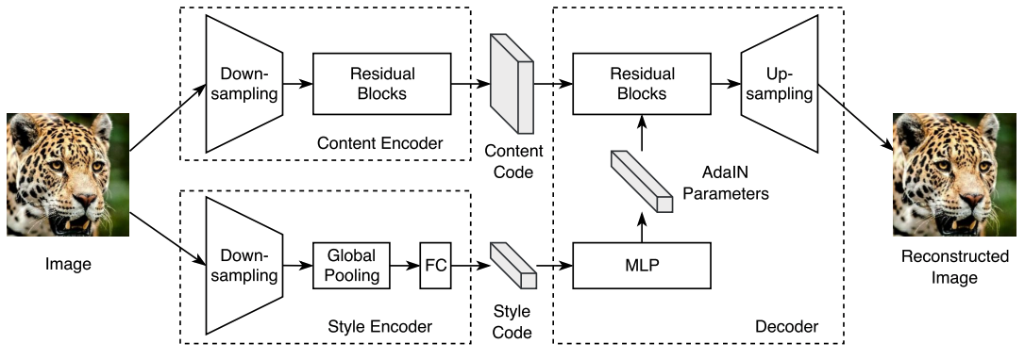
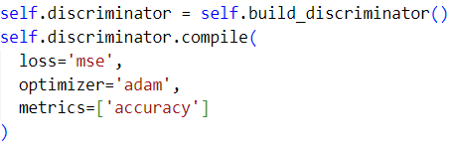
Encoder & Decoder + Discriminator
Encoder & Decoder
Discriminator
Conv layer + MSE loss function

Slide 12
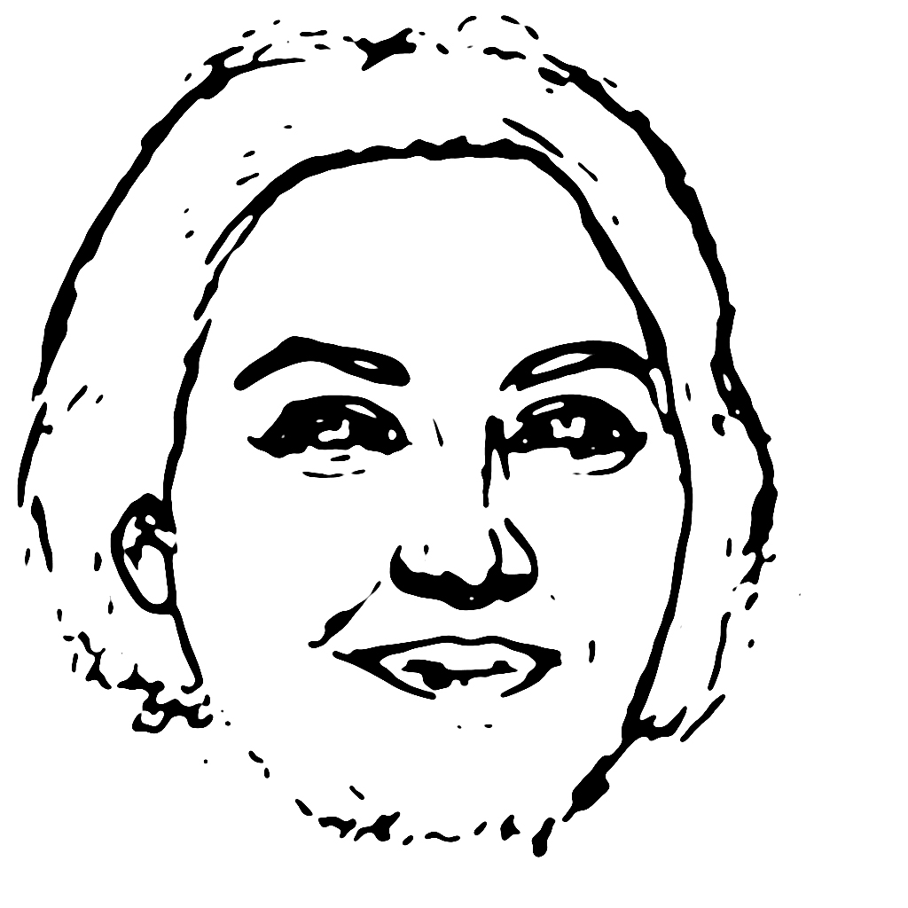
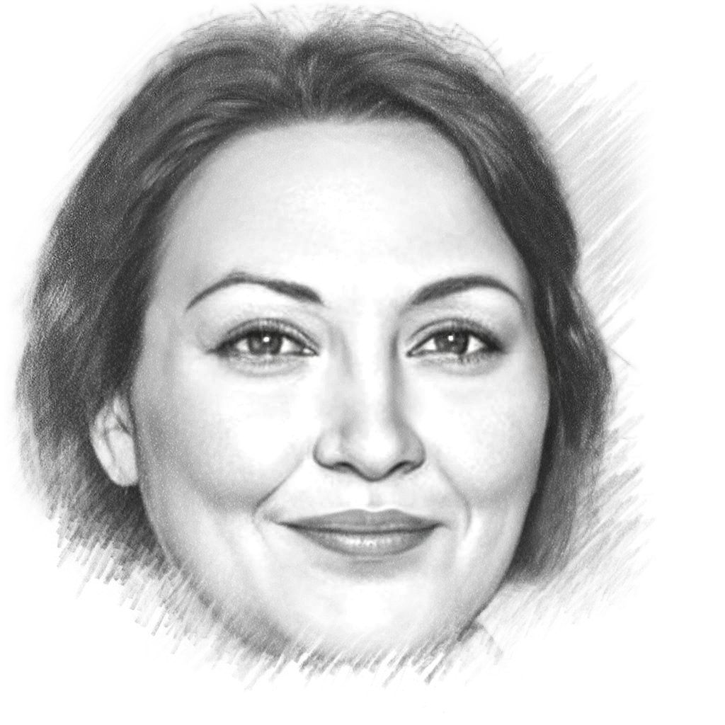
Image resizing
In order to reduce the data scale, speed up the model training speed and improve the model extraction effect, the input image would be reduced from 1024x1024 to 256x256, and the gererated image would be enlarged from 256x256 to 1024x1024
Channels：3 → 1 → 3
Model
256x256x1
1024x1024x3
256x256x1
1024x1024x3

Slide 13
Model Permormance
04

Slide 14
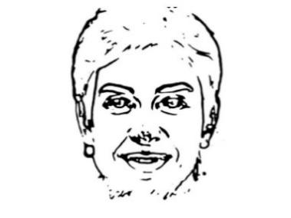
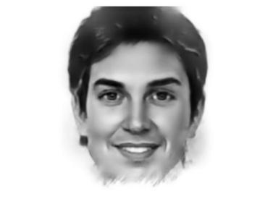
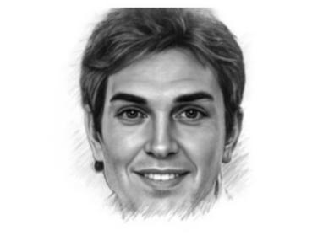
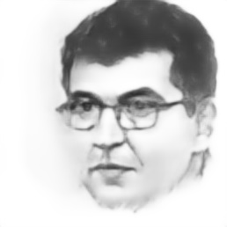
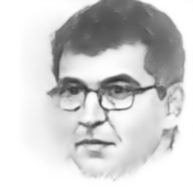
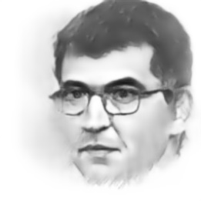
Performance
input
output
actual sketch
epoch=25
epoch=50
epoch=75

Slide 15
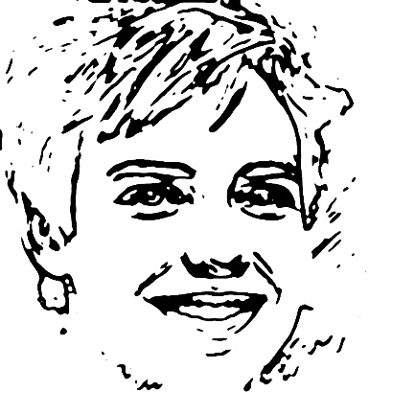
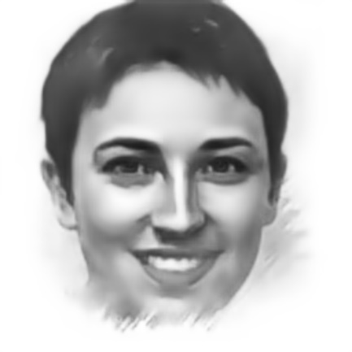
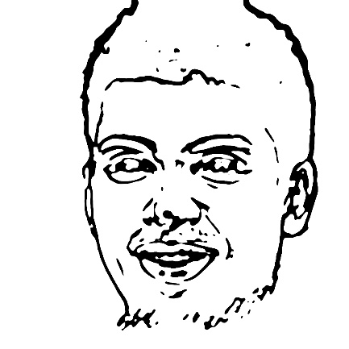
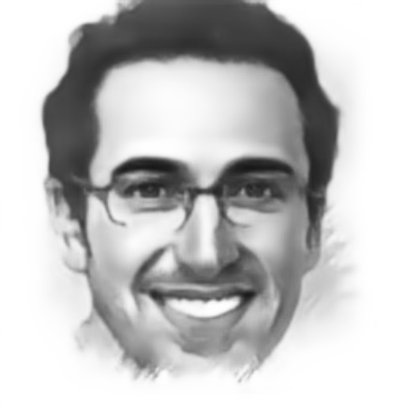
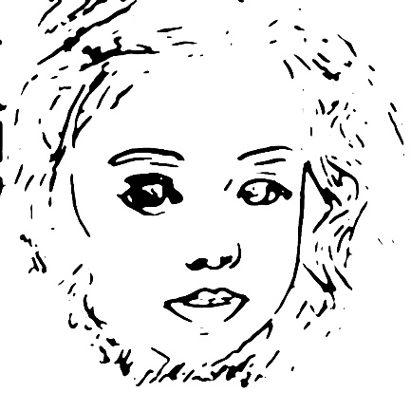
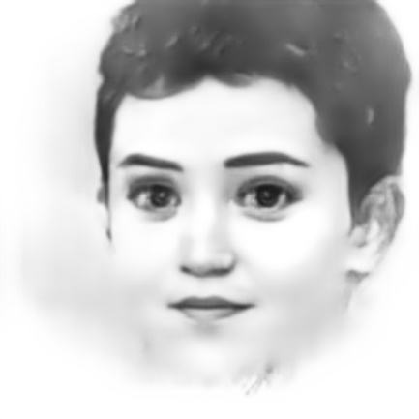
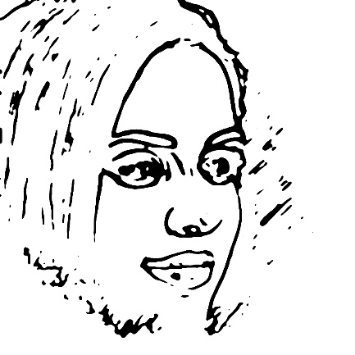
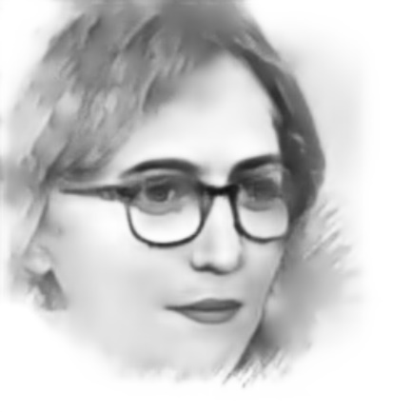
Performance

Slide 16
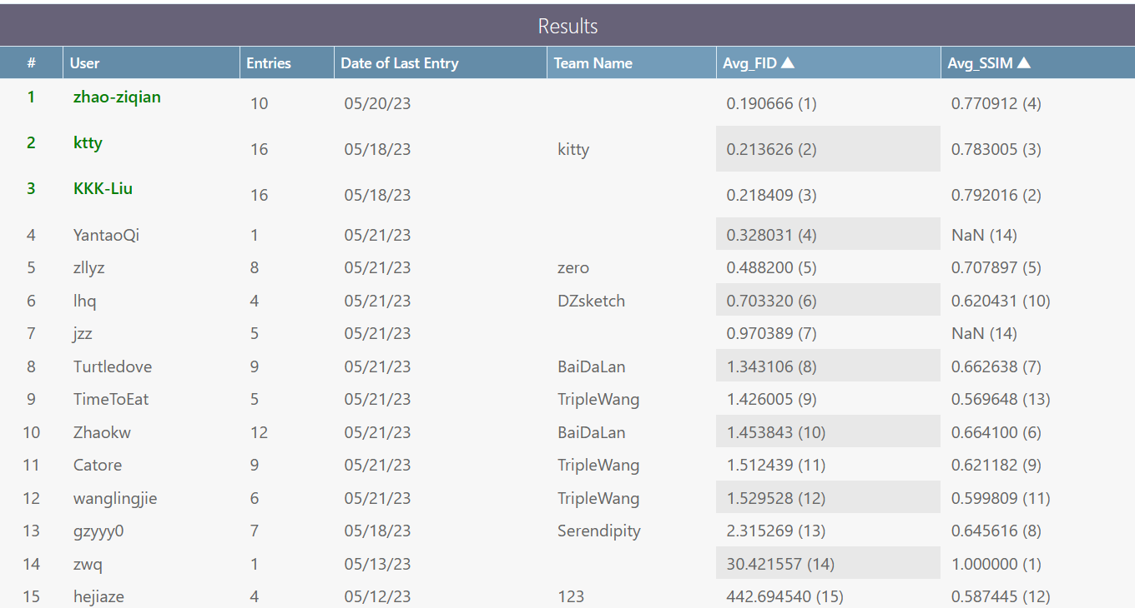
Evaluation
Evaluate the generated sketch images by FID and SSIM, results are as follows:
average FID: 0.488200
average SSIM: 0.707897

Slide 17
Conclusion
05

Slide 18
Conclusion
Our research successfully utilized the MUNIT model to create a new model that can generate a portrait sketch image from a portrait line image, achieving good performance.
Evaluated using FID and SSIM, our model generates high-quality sketchs and outdoes many other teams.
Our research provides an efficient tool for artists and designers, and also reveals its great potential in image style transfer field.

Slide 19
小组分工
王志远：调研 论文
宁振宇：调研 论文 答辩PPT
张露伊：调研 代码&训练 汇报

Slide 20
Inference
[1]Dong, C., Loy, C.C., He, K., Tang, X.: Learning a deep convolutional network for image super-resolution. In: ECCV. (2014)
[2]Xun Huang, Ming-Yu Liu, Serge Belongie, Jan Kautz: Multimodal Unsupervised Image-to-Image Translation [cs.CV] 14 Aug 2018
[3]Zhang, R., Isola, P., Efros, A.A.: Colorful image colorization. In: ECCV. (2016) 16 Xun Huang, Ming-Yu Liu, Serge Belongie, Jan Kautz
[4]16. Chen, X., Duan, Y., Houthooft, R., Schulman, J., Sutskever, I., Abbeel, P.: Infogan: Interpretable representation learning by information maximizing generative adversarial nets. In: NIPS. (2016)

Slide 21
感谢您的关注
THANK YOU

